Slide 1
CompTIA Security+ Guide to Network Security Fundamentals, Sixth Edition
Chapter 9
Client and Application Security

Slide 2
Objectives
9.1 List the steps for securing a client device
9.2 Define application security
9.3 Explain how physical security can be used for protection

Slide 3
Client Security
Securing the client involves:
Using hardware system security
Securing the operating system software
Protecting peripheral devices connected to the client

Slide 4
Hardware System Security
Protecting client hardware involves using different tools:
Secure booting tools
A hardware root of trust
Preventing electromagnetic spying

Slide 5
Secure Booting (1 of 2)
BIOS (Basic Input/Output System)
Firmware used on early computers to hold the boot process
Ability to update the BIOS with a firmware update opened the door for a threat actor to create malware to infect the BIOS
To combat BIOS attacks U E F I (Unified Extensible Firmware Interface) was developed to replace BIOS
In conjunction with U E F I
Secure Boot security standard was also created
When using U E F I and Secure Boot, a computer checks the digital signature of each piece of boot software
If signatures are deemed valid the computer boots
If not, computer does not boot

Slide 6
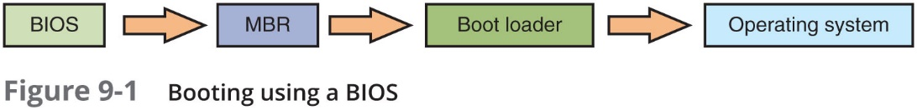
Secure Booting (2 of 2)

Slide 7
Hardware Root of Trust
Chain of trust
Each element (of the boot process) relies on the confirmation of the previous element to know that the entire process is secure
Hardware root of trust
Strongest starting point is hardware, which cannot be modified
Security checks are “rooted” in hardware checks

Slide 8
Electromagnetic Spying
Security researcher have found that it is possible to pick up electromagnetic fields and read data that is producing them
U.S. government has developed a classified standard
Intended to prevent attackers from picking up electromagnetic fields from government buildings
Known as Telecommunications Electronics Material Protected from Emanating Spurious Transmissions (T E M P E S T)

Slide 9
Supply Chain Infections
Supply chain
A network that moves a product from the supplier to the customer
The different steps in the supply chain has opened the door for malware to be injected into products during their manufacturing or storage
Called supply chain infections
Supply chain infections are considered dangerous
If malware is planted in the ROM firmware of a device, it can difficult or impossible to clean an infected device
Users may be receiving infected devices at the point of purchase, unaware of the infection
Cannot be easily prevented

Slide 10
Securing the Operating System Software
O S type | Uses | Examples
Network O S | Software that runs on a network device like a firewall, router, or switch | Cisco Internetwork O S (I O S), Juniper JUN OS, MikroTik Router O S
Server O S | O S software that runs on a network server to provide resources to network users | Microsoft Windows Server, Apple mac O S Server, Red Hat Linux
Workstation O S | Software that manages hardware and software on a client computer | Microsoft Windows, Apple mac OS, Ubuntu Linux
Appliance O S | O S in firmware that is designed to manage a specific device like a digital video recorder or video game console | Linpus Linux
Kiosk O S | System and user interface software for an interactive kiosk | Microsoft Windows, Google Chrome O S, Apple i O S, Instant WebKiosk, KioWare (Android)
Mobile O S | O S for mobile phones, smartphones, tablets, and other handheld devices | Google Android, Apple i O S, Microsoft Windows Mobile

Slide 11
O S Security Configuration
Typical O S security configuration should include:
Disabling unnecessary ports and services
Disabling default accounts/passwords
Employing least functionality
Application whitelisting/blacklisting
Instead of recreating the same security configuration on each computer
Tools can be used to automate the process
In Microsoft Windows
A security template is a collection of security configuration settings that can be deployed to other devices

Slide 12
Patch Management (1 of 5)
Operating systems have increased in size and complexity
New attack tools have made secure functions vulnerable
Security patch - software security update to repair discovered vulnerabilities
Feature update – includes enhancements to the software to provide new or expanded functionality
Does not address security vulnerability
Service pack - accumulates security updates and additional features
Patch management tools:
Tools for patch distribution
Patch reception

Slide 13
Patch Management (2 of 5)
Patch Distribution
Patches can sometimes create new problems
Vendor should thoroughly test before deploying
Automated patch update service
Manage patches locally rather than rely on vendor’s online update service
Advantages of automated patch update service
Downloading patches from a local server can save bandwidth and time
Administrators can approve or decline updates, force updates to install by specific date, and obtain reports on what updates each computer needs
Administrators can approve updates for “detection” only; allows them to see which computers will require the update without actually installing it

Slide 14
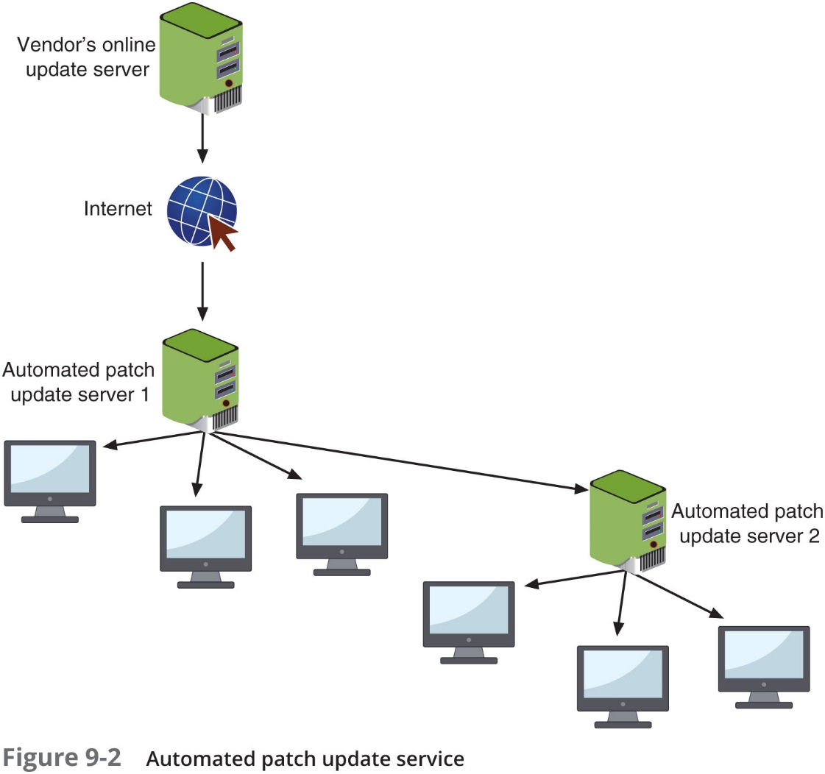
Patch Management (3 of 5)

Slide 15
Patch Management (4 of 5)
Patch Reception
Today, patches are automatically downloaded and installed
Ensures the software is always up-to-date
Microsoft changed its security update procedures and user options:
Forced updates
No selective updates
More efficient distribution
Up-to-date resets

Slide 16
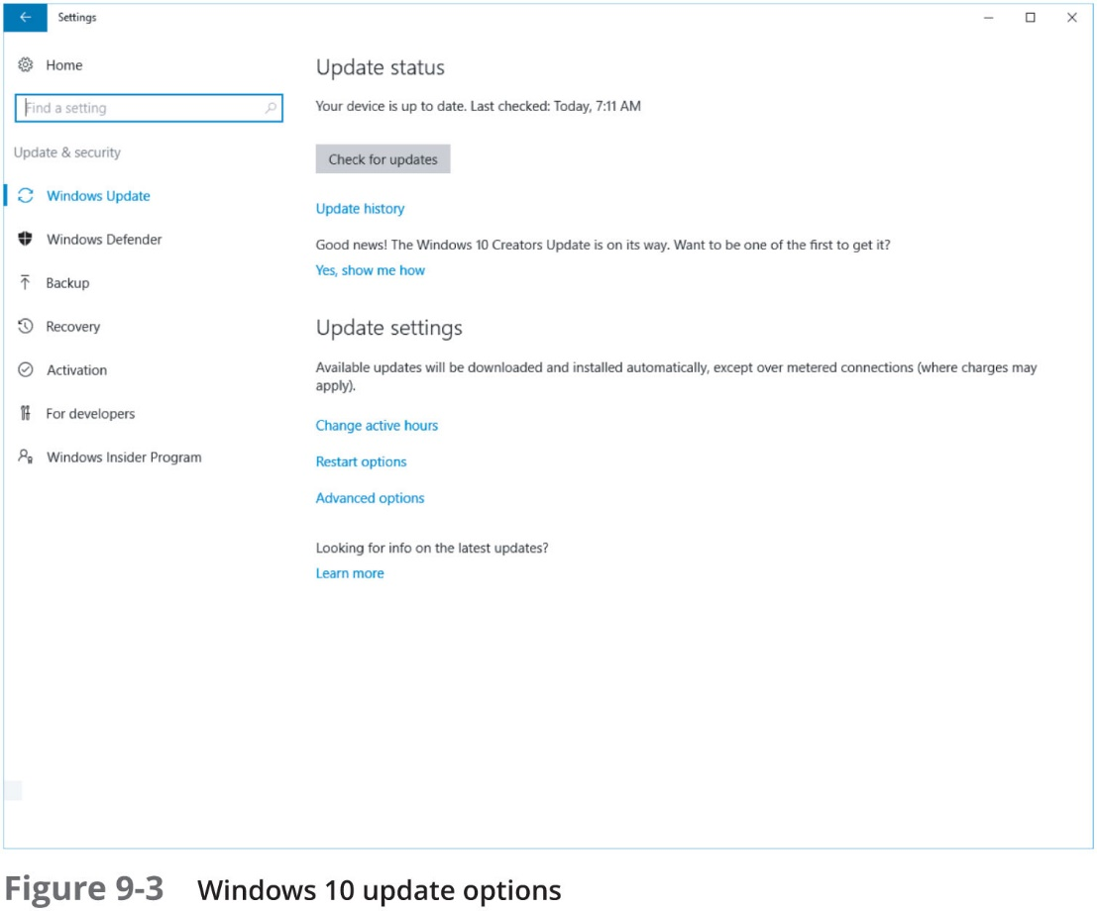
Patch Management (5 of 5)

Slide 17
Antimalware (1 of 5)
Antimalware software packages can provide added security
Antimalware software includes:
Antivirus
Antispam
Antispyware

Slide 18
Antimalware (2 of 5)
Antivirus (A V) - Software that examines a computer for infections
Scans new documents that might contain viruses
Searches for known virus patterns
Weakness of anti-virus
Vendor must continually search for new viruses, update and distribute signature files to users
A newer approach to A V is heuristic monitoring (called dynamic analysis)
Uses a variety of techniques to spot characteristics of a virus instead of attempting to make matches
One A V heuristic monitoring technique: code emulation
Questionable code is executed in virtual environment to determine if it is a virus

Slide 19
Antimalware (3 of 5)
Antispam
Mail gateway – monitors emails for spam and other unwanted content
Some spam can slip through
Antispam filtering software traps spam
Spam filtering methods
Create a list of approved and nonapproved senders
Blacklist - nonapproved senders
Whitelist - approved senders
Blocking certain file attachment types
Bayesian filtering - divides email messages into two piles: spam and nonspam

Slide 20
Antimalware (4 of 5)
Antispyware - helps prevent computers from becoming infected by different types of spyware
Pop-up - small window appearing over Web site
Usually created by advertisers
Pop-up blockers - a separate program as part of anti-spyware package
Incorporated within a browser
Allows user to limit or block most pop-ups
Alert can be displayed in the browser
Gives user option to display pop-up

Slide 21
Antimalware (5 of 5)
Trusted O S
O S hardening - tightening security during the design and coding of the O S
Trusted O S - an O S that has been designed through O S hardening
Trusted OS hardening technique | Explanation
Least privilege | Remove all supervisor or administrator accounts that can bypass security settings and provide the least-privileged unit to a user or process
Reduce capabilities | Significantly restrict what resources can be accessed and by whom
Read-only file system | Important O S files cannot be changed
Kernel pruning | Remove all unnecessary features that may compromise an O S

Slide 22
Peripheral Device Security (1 of 5)
Types of peripheral devices to be secured:
Devices using S D Input Output Cards
Digital cameras
External storage devices
Multifunctional devices
Displays

Slide 23
Peripheral Device Security (2 of 5)
Secure Digital Input Output (S D I O) Cards
Four families of S D cards:
S D S C
S D H C
S D X C
S D I O
S D I O – a storage card with integrated wireless transmission capabilities
Wi-Fi enabled micro S D card – an S D I O device used in devices like digital cameras
Security for an S D I O card is the same as for securing a standard Wi-Fi network

Slide 24
Peripheral Device Security (3 of 5)
Digital Cameras
Uses internal storage and external S D cards
Three types of speed classes:
Standard speed class
Ultra-high speed (U H S) class
Video speed class
Protecting data on S D cards can be accomplished:
Password-protecting the card
Using encryption
Write-protecting the card by moving a small external switch to the Open position

Slide 25
Peripheral Device Security (4 of 5)
External Storage Devices
At risk for infection by crypto-malware
Crypto-malware encrypts all files on any network or attached device that is connected to that computer
Includes:
Secondary hard disk drives
U S B hard drives
Network-attached storage devices
Network servers
Cloud-based data repositories (Dropbox, Apple iCloud, etc…)

Slide 26
Peripheral Device Security (5 of 5)
Device | Recommended protection
External U S B or e-S A T A storage device | Unplug the device from computer when not in use and attach it when needed
Secondary hard disk drive | Unmount the drive when it is not needed by using the mountvol D: /p command or Windows Disk Management utility then mount the drive when necessary
Network-attached storage device | Create a new folder and then create a new user account with a strong password that is the only account that has access to it, and log in and out of that, share as needed
Cloud storage | Turn off automatic synchronization so that files placed in a folder are not immediately synced to the cloud storage

Slide 27
Multifunctional Devices
Multifunctional device (M F D)
Combines the functions of a printer, copier, scanner, and fax machine
Recommended protections:
Locate the M F D in a secure area
Configure the M F D with security in mind by changing any default passwords, turning on hard drive encryption, requiring that all stored images be purged, and setting the device to receive latest security patches
Separate the M F D print server from the network server
Link the print management software to existing data loss prevention (D L P)
Minimize the risk of paper-based thefts by using Secure Job Release
Make use of semi-visible watermark technology
When disposing of, internal drive should be wiped, removed, or destroyed

Slide 28
Displays
Computer displays
Often considered “passive” peripherals
Security researchers have demonstrated that a threat actor can target a display’s firmware
Could enable attacker to view what is being projected on the display

Slide 29
Physical Security
Physical security includes:
External perimeter defenses
Internal physical access security
Security for protecting the hardware device itself

Slide 30
External Perimeter Defenses
External perimeter defenses are designed to restrict access to equipment areas
This type of defense includes:
Barriers
guards
Motion detection devices

Slide 31
Barriers (1 of 2)
Fencing - usually a tall, permanent structure
Modern perimeter fences are equipped with other deterrents such as proper lighting and signage
Cage – a fenced secure waiting station area
Such as an area that can contain visitors to a facility until they can be approved for entry
Barricade - large concrete ones should be used
Bollard – short but sturdy vertical post that is used as a vehicular traffic barricade to prevent a car from “ramming” into a secured area

Slide 32

Barriers (2 of 2)

Slide 33
Security Guards
Human security guards are considered active security elements
Video surveillance cameras transmit a signal to a specific and limited set of receivers called closed circuit television (C C T V)
Frequently used for surveillance in areas that require security monitoring such as banks, casinos, airports, and military installations

Slide 34
Motion Detection
Motion Detection
Determining an object’s change in position in relation to its surroundings
This movement usually generates an audible alarm
Method | Example
Visual | C C T V
Radio frequency | Radar, microwave
Vibration | Seismic sensors
Sound | Microphones
Magnetism | Magnetic sensors
Infrared | Passive and active infrared light sensors

Slide 35
Internal Physical Access Security
These protections include:
Door locks
Access logs
Mantraps
Protected distribution systems for cabling

Slide 36
Door Locks (1 of 3)
Door locks
Standard keyed entry lock provides minimal security
Deadbolt locks provide additional security and require that a key be used to both open and lock the door
Cipher locks are combination locks that use buttons that must be pushed in the proper sequence
Can be programmed to allow a certain individual’s code to be valid on specific dates and times

Slide 37
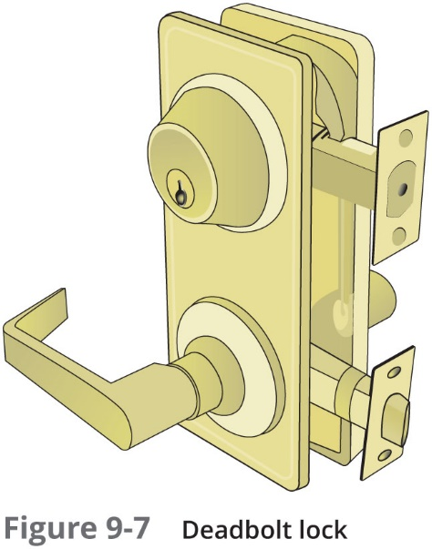
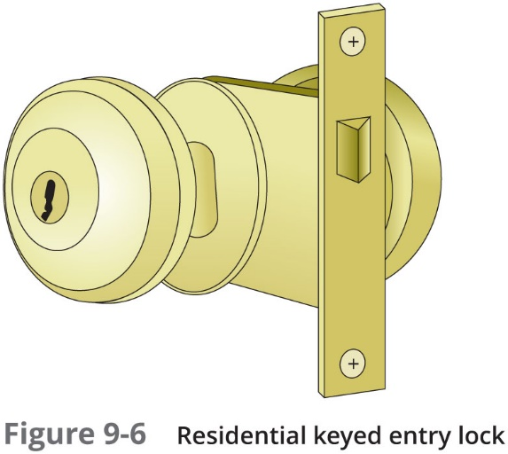
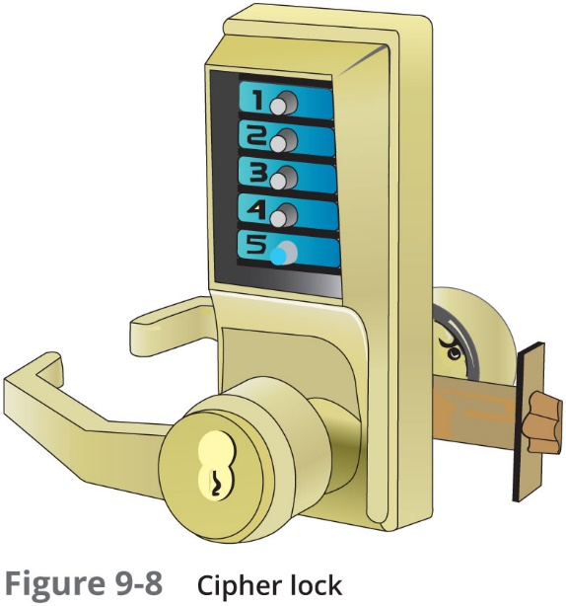
Door Locks (2 of 3)

Slide 38
Door Locks (3 of 3)
Key management procedures:
Keep track of keys issued and require users to sign their name when receiving keys
Receive the proper approvals of supervisors or other appropriate persons before issuing keys
When making duplicates of master keys, mark them “Do Not Duplicate” and wipe out manufacturer’s serial numbers
Secure unused keys in a locked safe
Change locks immediately upon loss or theft of keys

Slide 39
Access Logs
Access list
Record of individuals who have permission to enter secure area
Records time they entered and left
Today, cipher locks and other technology can create electronic access logs

Slide 40
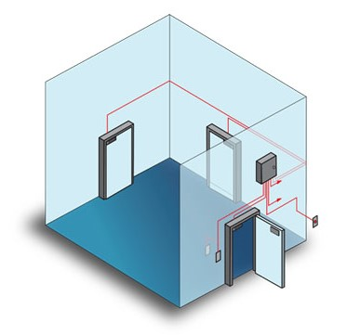
Mantraps
Mantrap
Separates a secured from a nonsecured area
A mantrap device monitors and controls two interlocking doors
Only one door may open at any time
Used at high-security areas where only authorized persons can enter
Such as cash handling areas and research laboratories

Slide 41
Protected Distribution Systems (P D S) (1 of 3)
Protected Distribution Systems (P D S)
A system of cable conduits used to protect classified information that is being transmitted between two secure areas
Created by the U.S. Department of Defense (D O D)
Two types of P D S:
Hardened carrier P D S - conduit constructed of special electrical metallic tubing
Alarmed carrier P D S - specialized optical fibers in the conduit that sense acoustic vibrations that occur when an intruder attempts to gain access

Slide 42
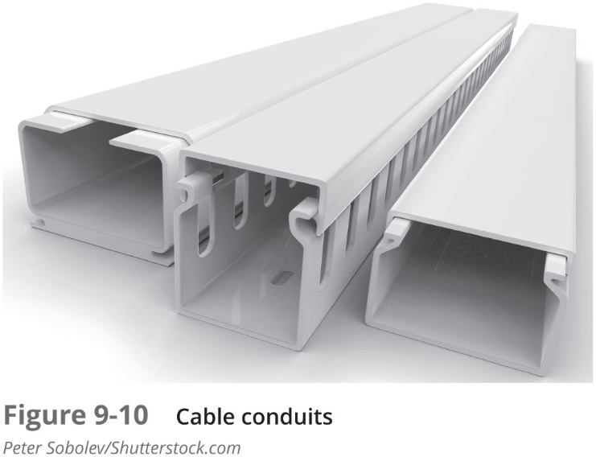
Protected Distribution Systems (P D S) (2 of 3)

Slide 43
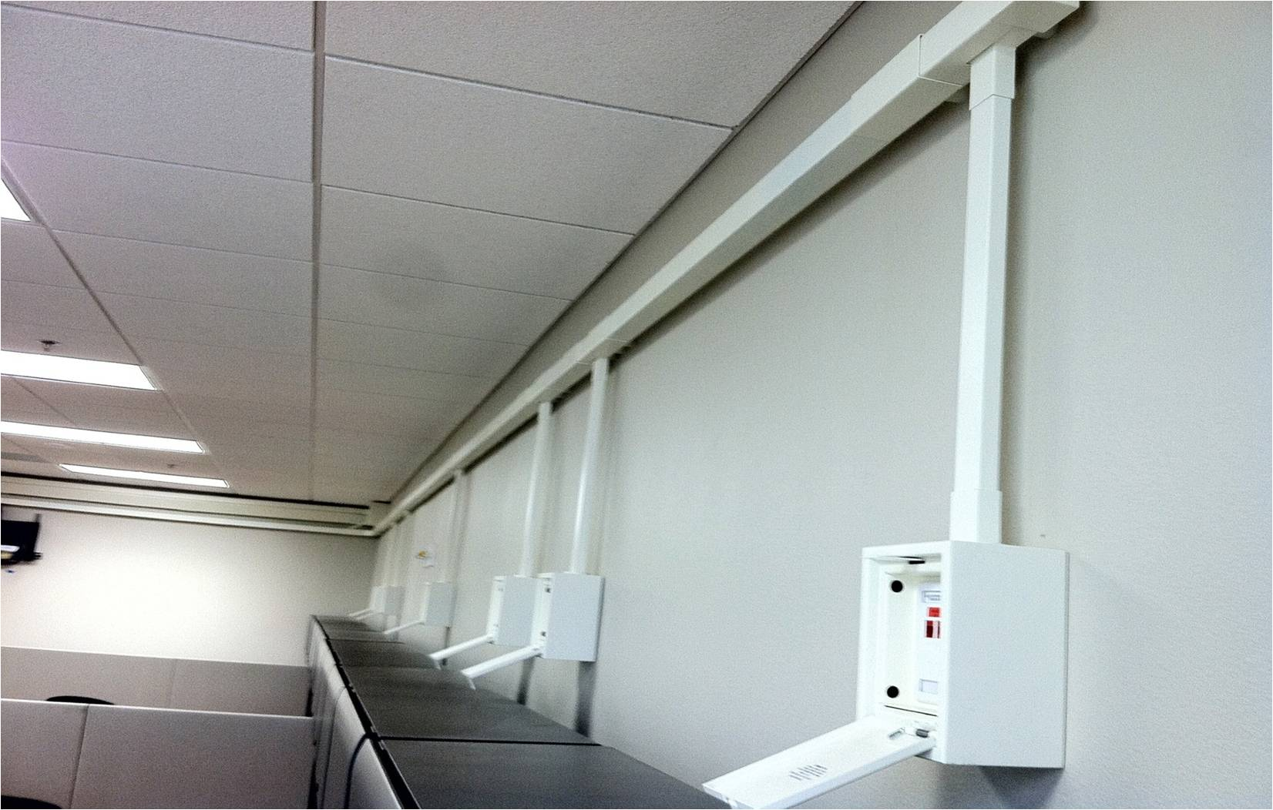
Protected Distribution Systems (P D S) (2 of 3)
Protected Distribution System

Slide 44
Computer Hardware Security
Computer hardware security - the physical security protecting the hardware of the host system
Most portable devices have a steel bracket security slot
A cable lock can be inserted into slot and secured to device and a cable connected to the lock can be secured to a desk or chair
Safe or secure cabinet
Can be prewired for power and network connections
Allow devices to charge while stored as well as receive updates

Slide 45
Application Security
Besides protecting O S software on hosts, there is a need to protect applications that run on these devices
Aspects of application security:
Application development security
Secure coding techniques
Code testing

Slide 46
Application Development Concepts (1 of 3)
Application development stages:
Development
Testing
Staging
Production
Application development lifecycle models:
Waterfall model
Agile model

Slide 47
Application Development Concepts (2 of 3)
Secure DevOps methodology includes
Security automation
Continuous integration
Immutable systems
Infrastructure as code
Baselining
Provisioning
The enterprise-wide configuration, development, and management of multiple types of I T system resources
Deprovisioning
In application development is removing a resource that is no longer needed

Slide 48
Application Development Concepts (3 of 3)
Because DevOps is based on the agile method
There will be continuous modifications throughout the process
Important to use tools that support change management
One tool for change management is version control software that allows changes to be automatically recorded and if necessary “rolled back” to a previous version of the software

Slide 49
Secure Coding Techniques
There are several coding techniques that should be used to create secure applications and limit data exposure:
Determining how encryption will be implemented
Ensuring that memory management is handled correctly so as not to introduce memory vulnerabilities

Slide 50
Code Testing (1 of 2)
At the beginning of the process a model verification test is used to ensure that the projected application meets all specifications at that point
Compiled code testing
Searches for errors that could prevent the application from properly compiling from source code to application code
Runtime code testing
Looks for errors after the program has compiled correctly and is running
Most runtime code testing is done in a sandbox, which is a testing environment that isolates the untested code from the live production environment

Slide 51
Code Testing (2 of 2)
Static program analyzers
Tools that examine software without executing the program
Just the source code is reviewed and analyzed
Dynamic analysis (fuzzing)
A software testing technique that deliberately provides invalid, unexpected, or random data as inputs to a program
Stress testing
Puts the application under a heavier than normal load to determine if the program is robust and can perform all error handling correctly
Integrity measurement
An “attestation mechanism” designed to be able to convince a remote party that an application is running only a set of known and approved executables

Slide 52
Review Questions
A lock that extends a solid metal bar into the door frame for extra security is the _____.
A. triple bar lock
B. deadman’s lock
C. full bar lock
D. deadbolt lock
Which of the following is NOT a typical OS security configuration?
A. Employing least functionality
B. Restricting patch management
C. Disabling default accounts/passwords
D. Disabling unnecessary ports and services
What allows for a single configuration to be set and then deployed to many or all users?
A. Snap-In Replication (SIR)
B. Active Directory
C. Group Policy
D. Command Configuration

Slide 53
Chapter Summary (1 of 3)
Secure Boot is designed to ensure that a computer boots using only software that is trusted by the computer manufacturer
In a chain of trust each element relies on the confirmation of the previous element to know that the entire process is secure
Strongest starting point is hardware
In addition to protecting hardware, the O S software that runs on the host also must be protected
Modern O Ss have hundreds of different security settings that can be manipulated to conform to the baseline

Slide 54
Chapter Summary (2 of 3)
Antimalware software can help protect against these infections
A V software can examine a computer for any infections as well as monitor computer activity and scan new documents that might contain a virus
Peripheral devices attached to a client computer must likewise be protected
A multifunctional device (M F D) is a combination printer, copier, scanner, and fax machine and should also be protected
Physical security is an often overlooked consideration when protecting a client device
Door locks are important to protect equipment
Hardware security is physical security that involves protecting the hardware of the host system

Slide 55
Chapter Summary (3 of 3)
Applications that run on client devices need to be secure
There are different tools and processes that can be used to test the quality of the application code

